Slide 1
Element of Art LINE…a drawing lesson for kids
Line. Lines and curves are marks that span a distance between two points (or the path of a moving point). As an element of visual art, line is the use of various marks, outlines, and implied lines during artwork and design. A line has a width, direction, and length. A line's width is most times called its "thickness". Line is the foundation of all drawing.
There are 5 types of LINE:
Vertical Horizontal Zig Zag Diagonal Curved
Everyone take a pencil and paper and draw each of these lines with me!

Slide 2
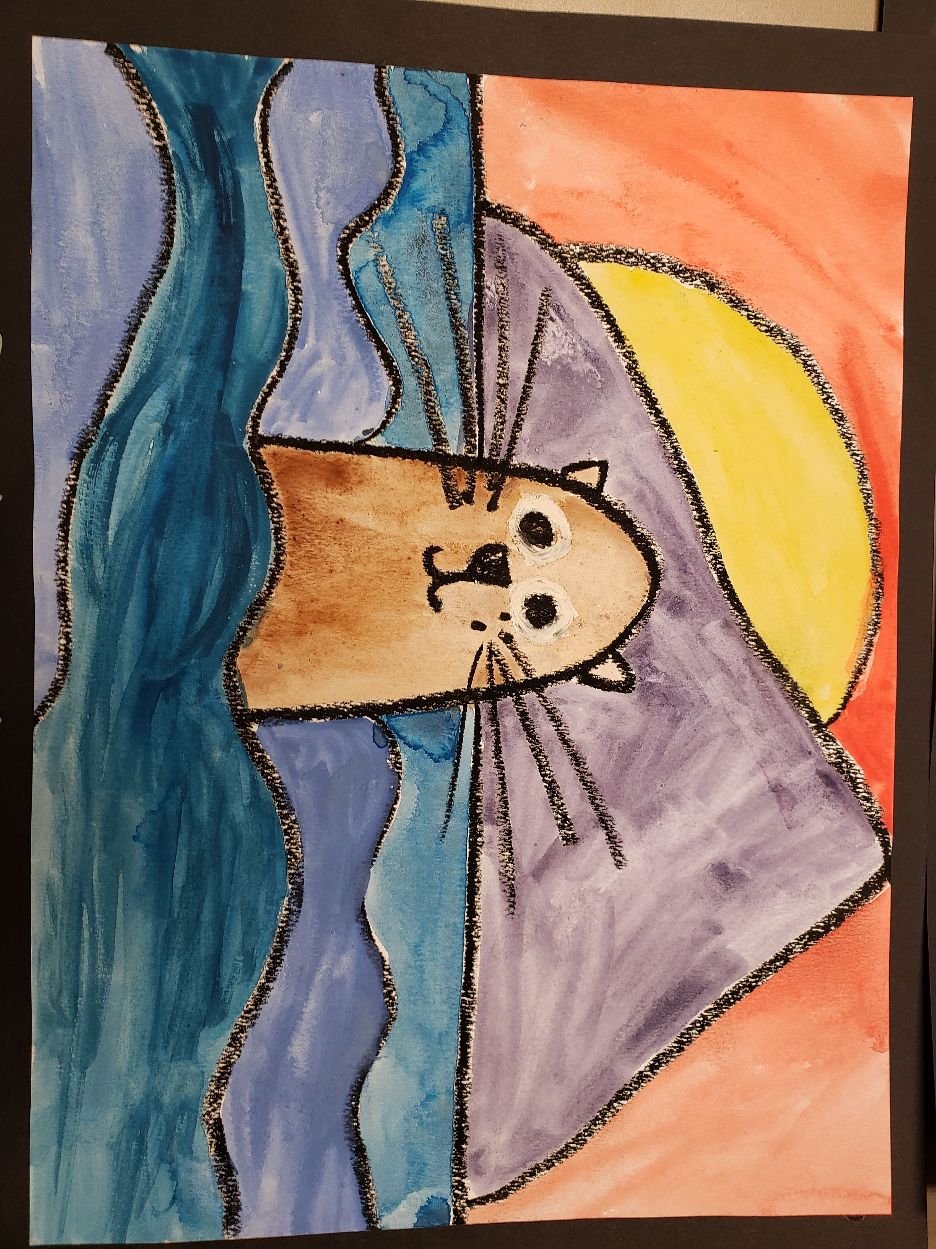
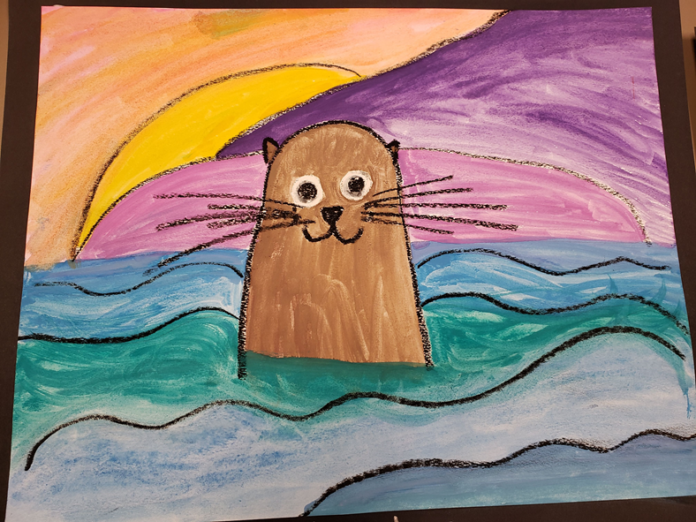
TODAY- we will use a series of lines to draw our Creekside mascot…an OTTER!

Slide 3
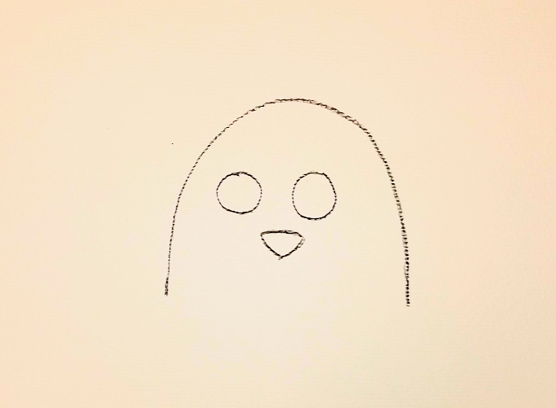
Write your name on the back of your paper
Draw a curved line to create the otter’s head.
Leave the bottom open as his body will be under the water.
Make the head as big or a little bigger than your hand on the paper.
Add 2 circles for eyes, and a rounded triangle for the nose.

Slide 4
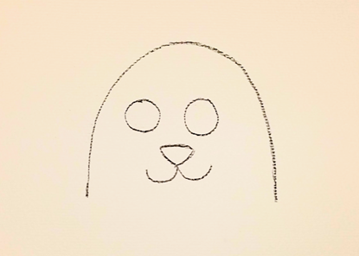
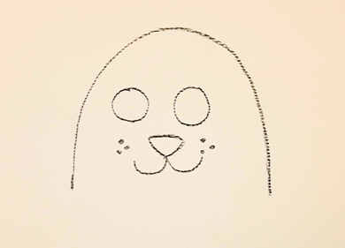
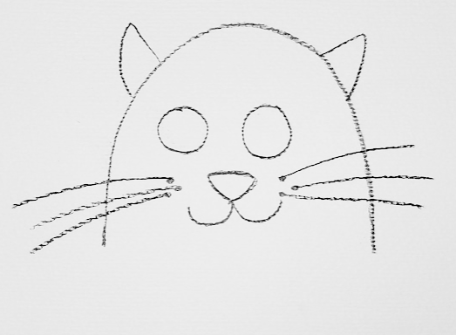
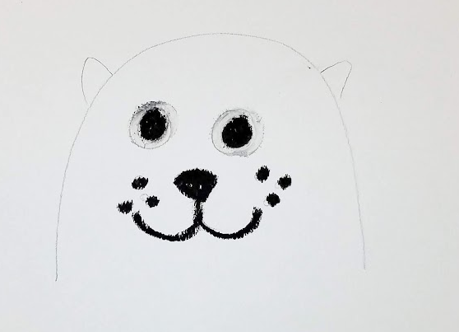
Add 2 curved lines under his nose giving your otter a smile.
Add a few dots on each side of his cheeks, and then draw some longer lines from those dots to create whiskers.
Draw 2 small peaks or triangles on the sides of his head for his ears.

Slide 5
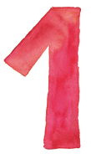
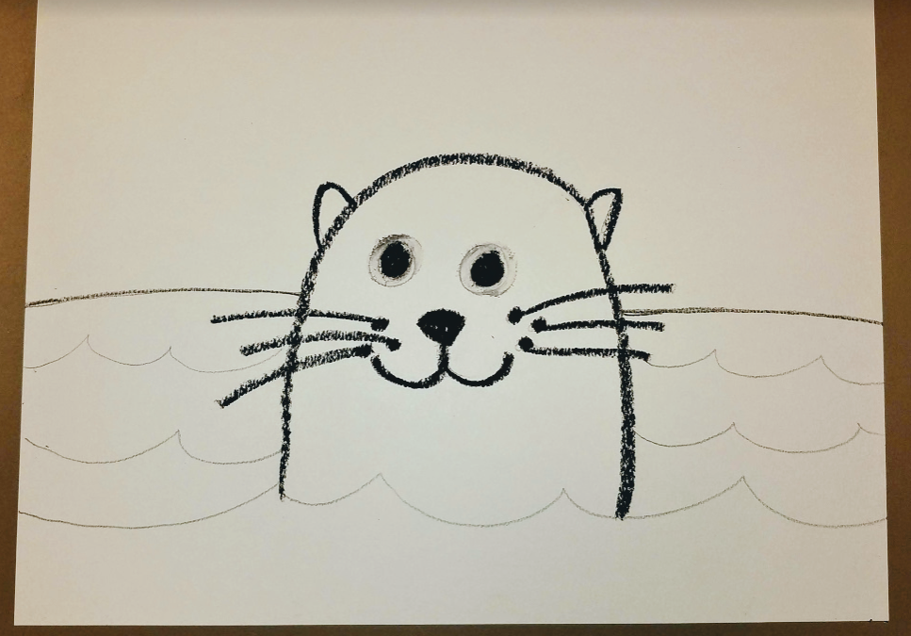
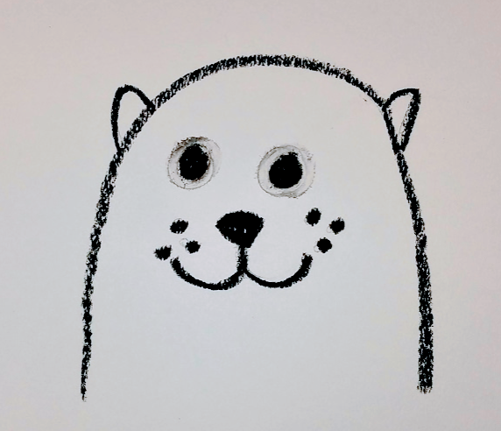
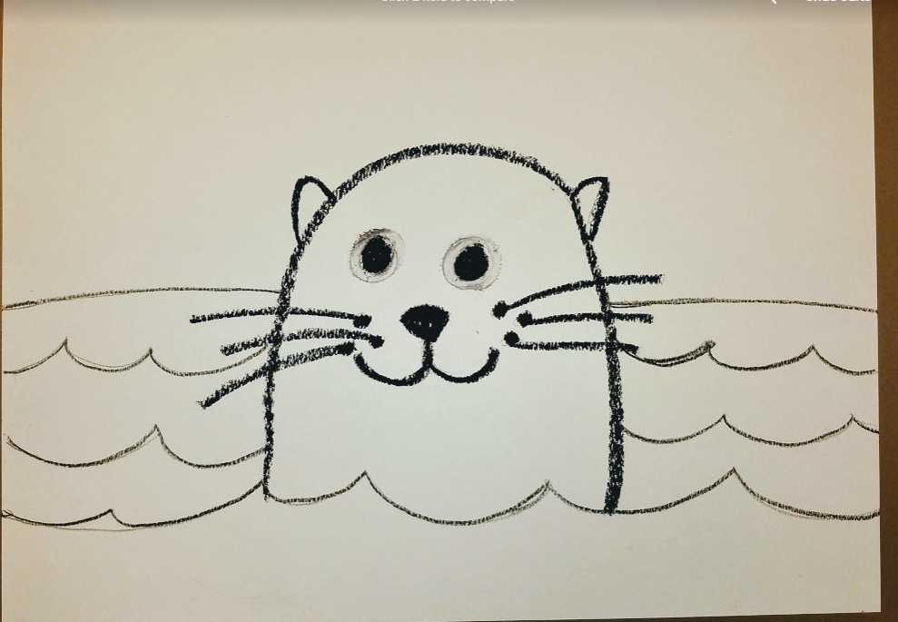
Using your WHITE oil pastel, fill in the whites of the otters eyes. This will help make the eye pop when we use our watercolors
Using your BLACK oil pastel, trace your all pencil lines carefully.
Using your pencil, draw a horizontal line to create the horizon. Start on the right side of the paper, draw across to the otter and hop over his head to the other side. Continue until you reach the end of the paper.
Add some additional curved lines for the water. Again, hop over the otter’s head with the lines. Do not draw lines over your otter.

Slide 6
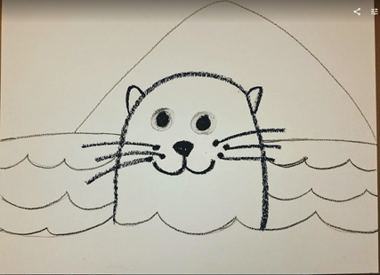
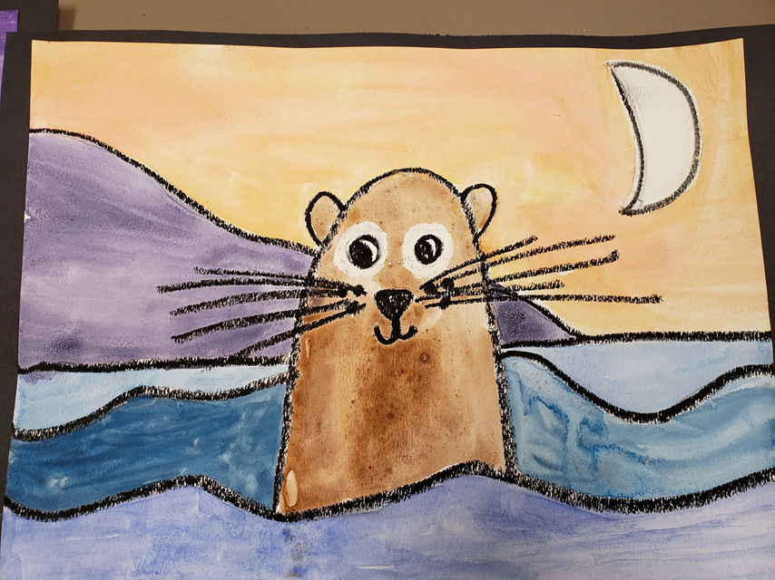
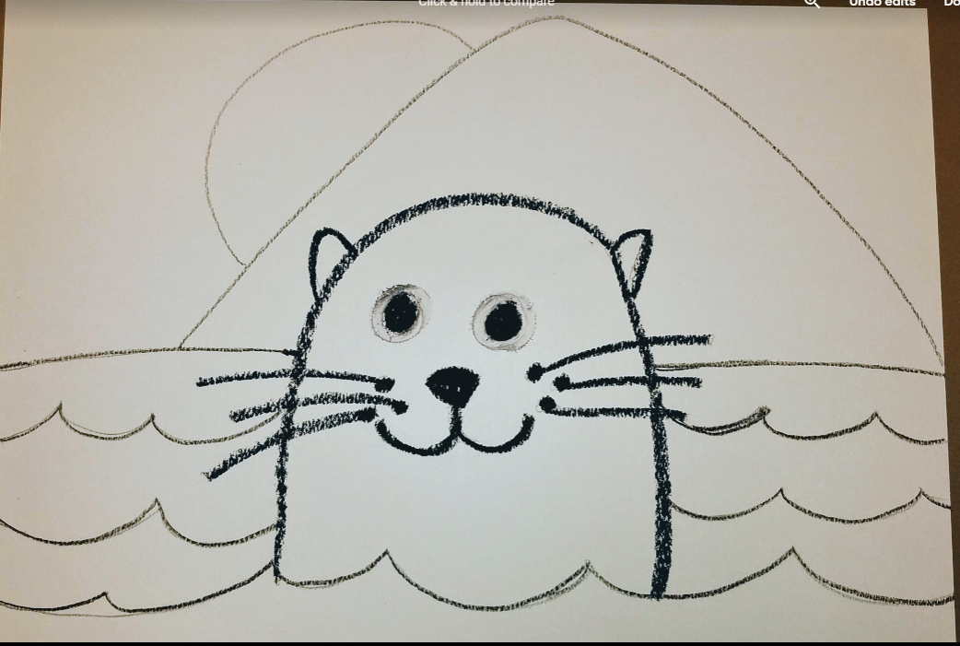
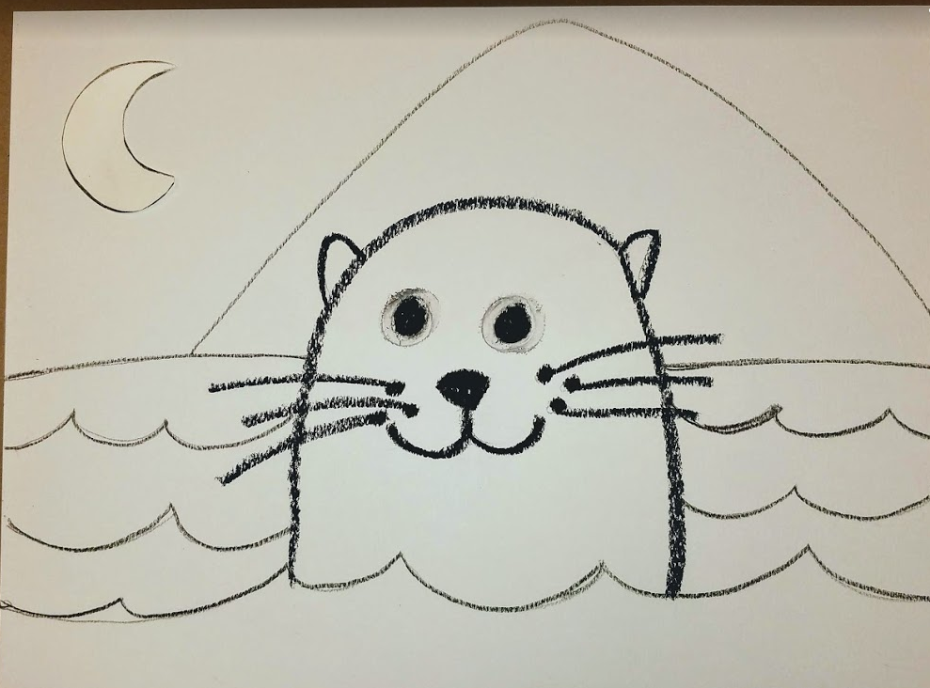
The last part of our drawing is the background.
Add a mountain or hill using long curved lines.
Add a circle behind the mountain for a sunset, or a circle in the sky as the moon.
Do it now - If you chose a moon, color it in with your white oil pastel.
If you choose a sun, we will paint it yellow, later.

Slide 7
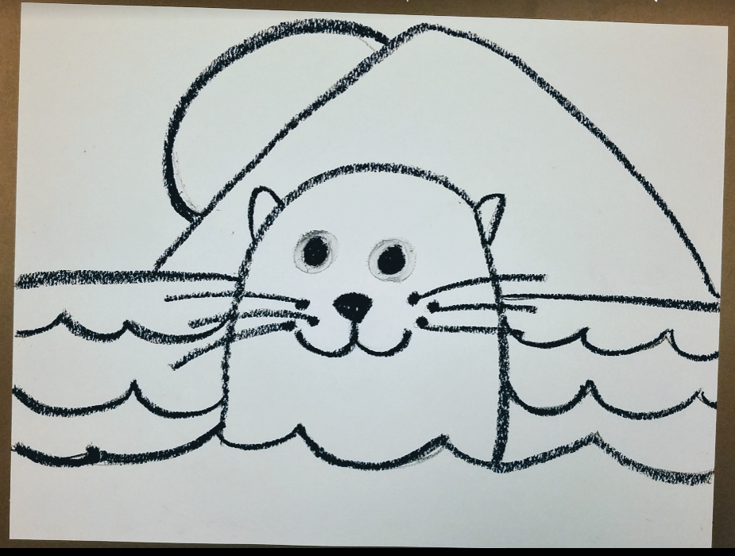
Outline all your lines using the black oil pastel.
Be careful not to smear the lines with your wrist.

Slide 8
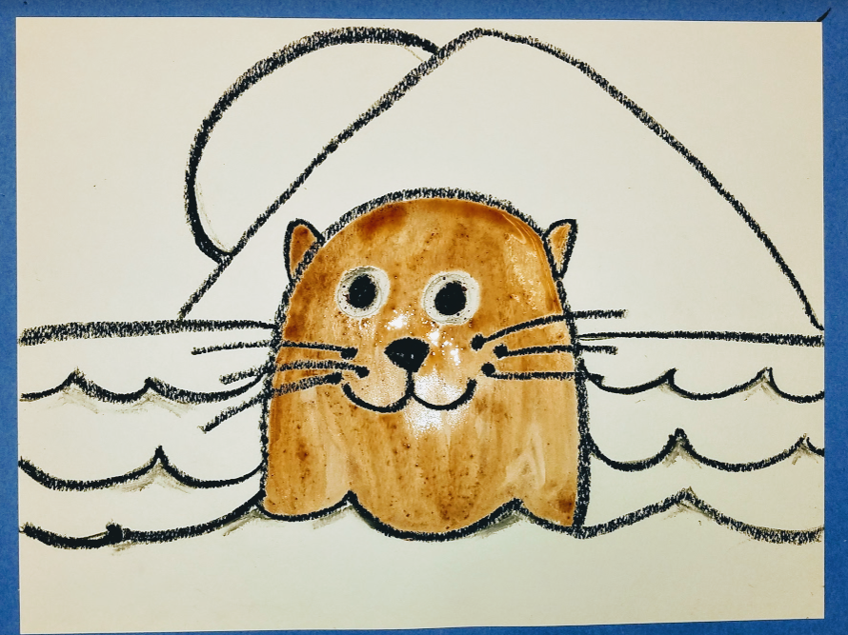
LIQUID WATERCOLORS
We will be using liquid watercolors today.
These special paints come in small tubes and are highly concentrated colors. We use a small dot of paint and mix a lot of water into it to create vibrant watery colors.
Begin painting your otter using the brown watercolor.
Be sure to wash and dry your brush between colors.

Slide 9
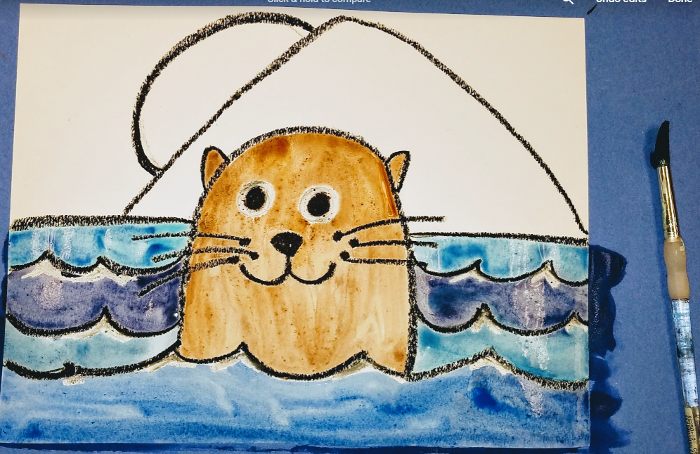
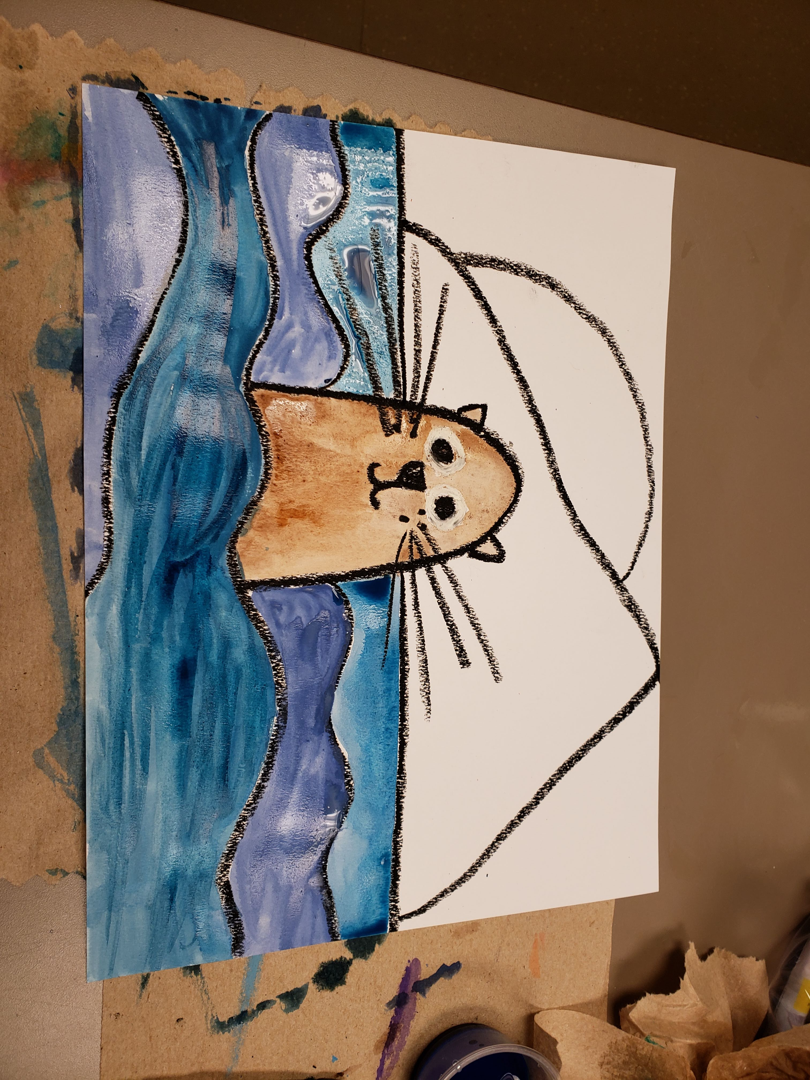
Use different variations of blue watercolor for each wave line.

Slide 10
What colors are a sunset or sunrise?
Sunset Sunrise
Always lighter closer to the sun. Top color depends on if it is a set or a rise.

Slide 11
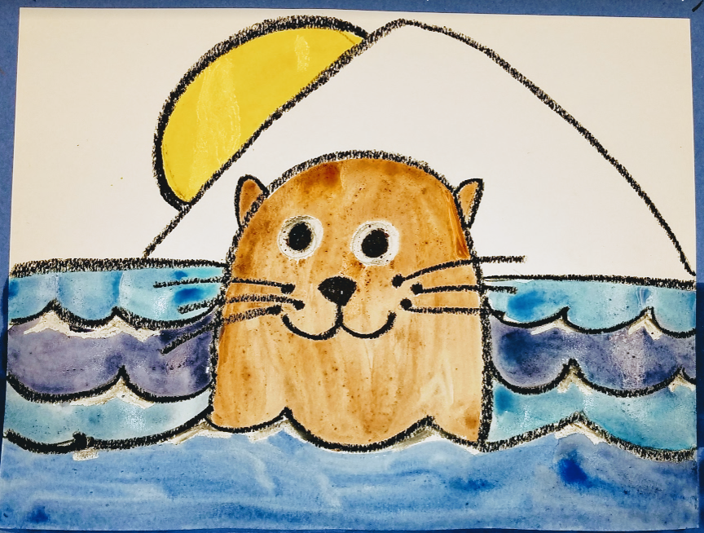
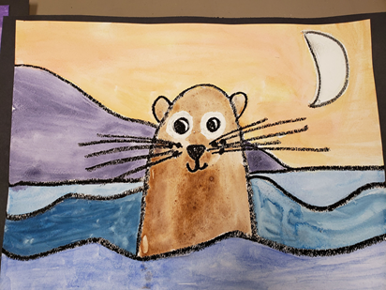
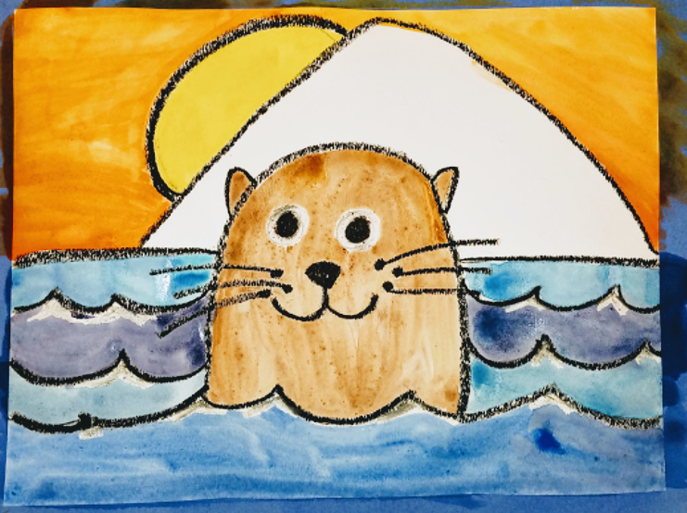
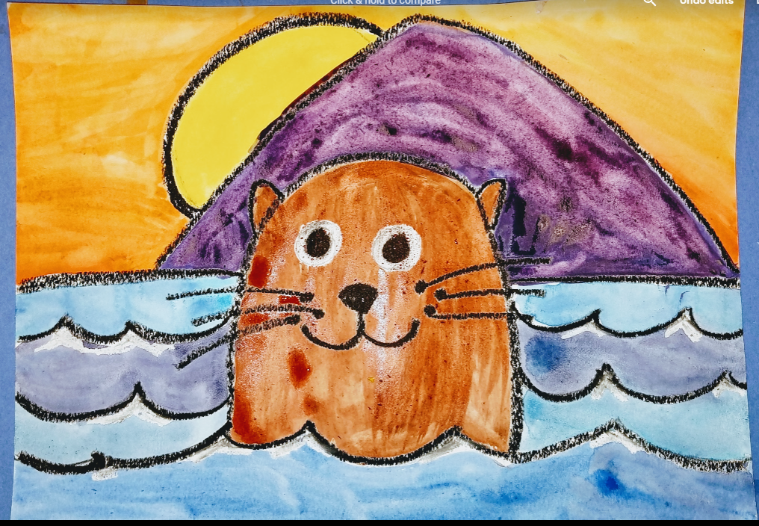
If you choose a sun, paint it yellow. If it is a moon, color it with your white oil pastel.
Paint the horizon and mountain.

Slide 12
We used a series of LINES to draw our otter picture today. What else could you draw using lines? Anything you can image!

